Slide 1
3
Structured Program Development in C

Slide 2
3.1 Introduction
Before writing a program:
  Have a thorough understanding of the problem
  Carefully plan an approach for solving it
While writing a program:
  Know what “building blocks” are available
  Use good programming principles

Slide 3
3.2 Algorithms
Computing problems
  All can be solved by executing a series of actions in a specific order
Algorithm: procedure in terms of
  Actions to be executed
  The order in which these actions are to be executed
Program control
  Specify order in which statements are to be executed

Slide 4
3.3 Pseudocode
Pseudocode
  Artificial, informal language that helps us develop algorithms
  Similar to everyday English
  Not actually executed on computers
  Helps us “think out” a program before writing it
    Easy to convert into a corresponding C++ program
    Consists only of executable statements

Slide 5
3.4 Control Structures
All programs are written in terms of 3 control structures:
  Sequence structures: Built into C. Programs executed sequentially by default, Statements executed one after the other in the order written
  Selection structures: C has three types: if, Ternary condition, and switch
  Repetition structures: C has three types: while, do…while and for

Slide 6
Operators
Types of Operators used in C:
  Arithmetic Operators
  Relational and Logical Operators
  Assignment Operators
  Increment or Decrement Operators

Slide 7
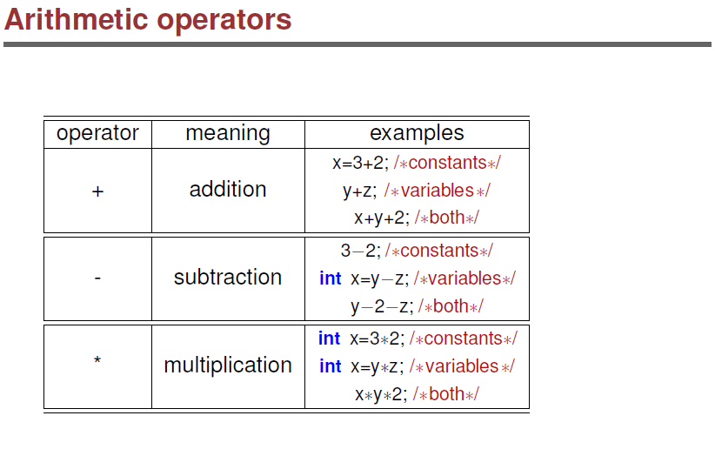


Slide 8
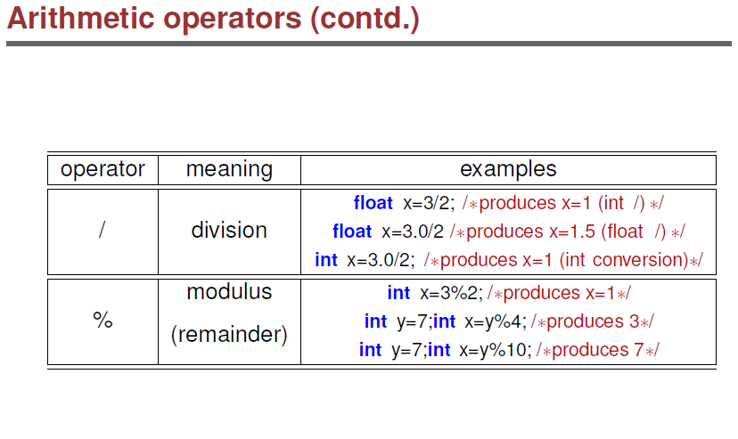

Slide 9
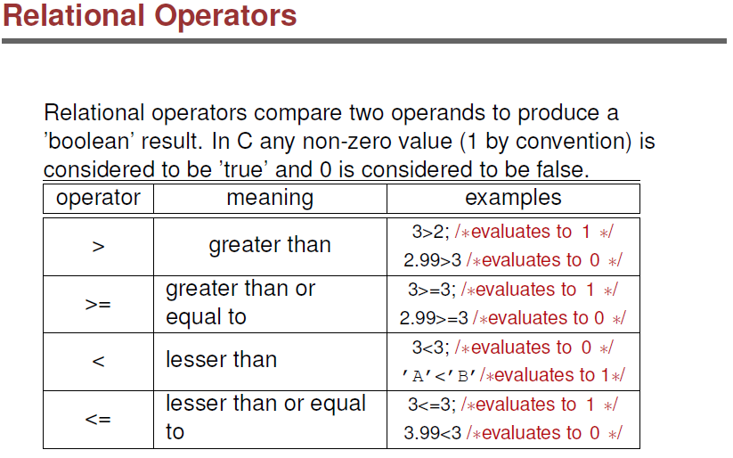

Slide 10
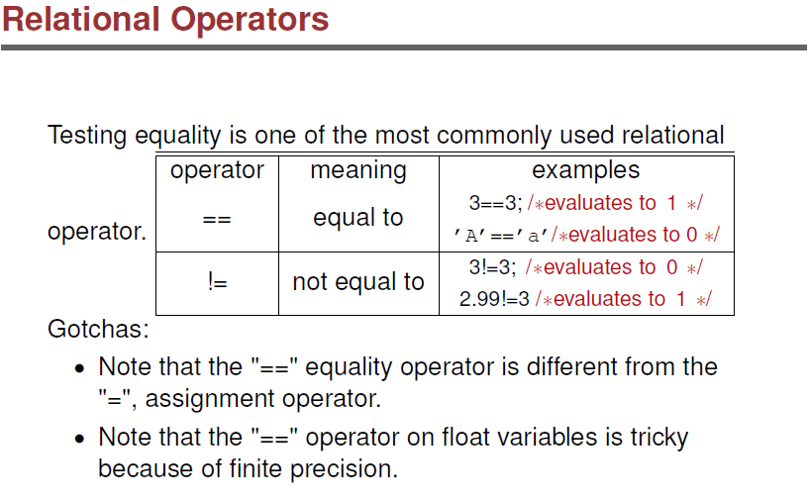

Slide 11
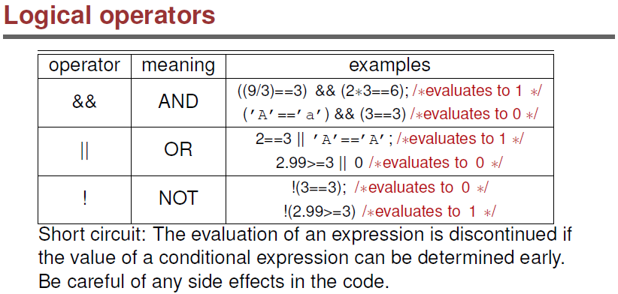

Slide 12
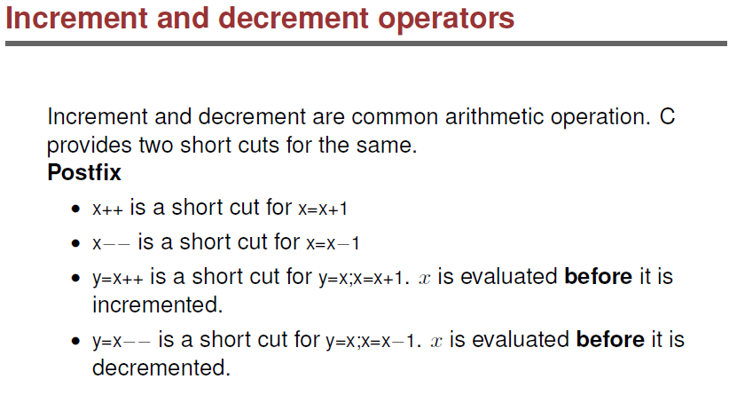

Slide 13
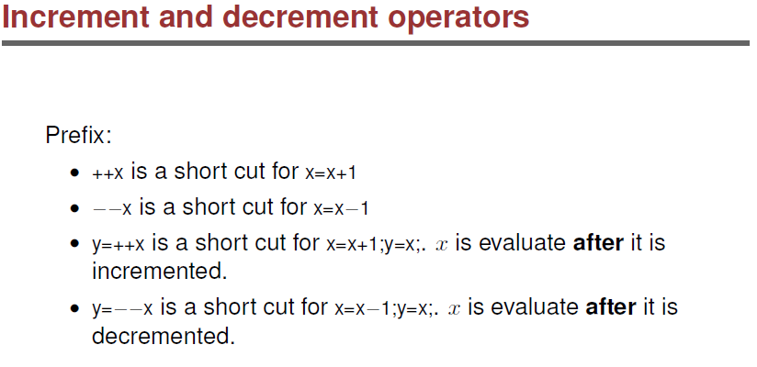

Slide 14
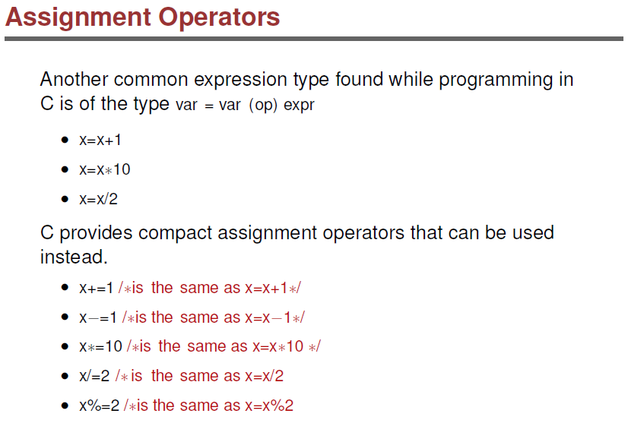

Slide 15
Selection structures
C has three types:
  if,
  Ternary condition,
  switch

Slide 16
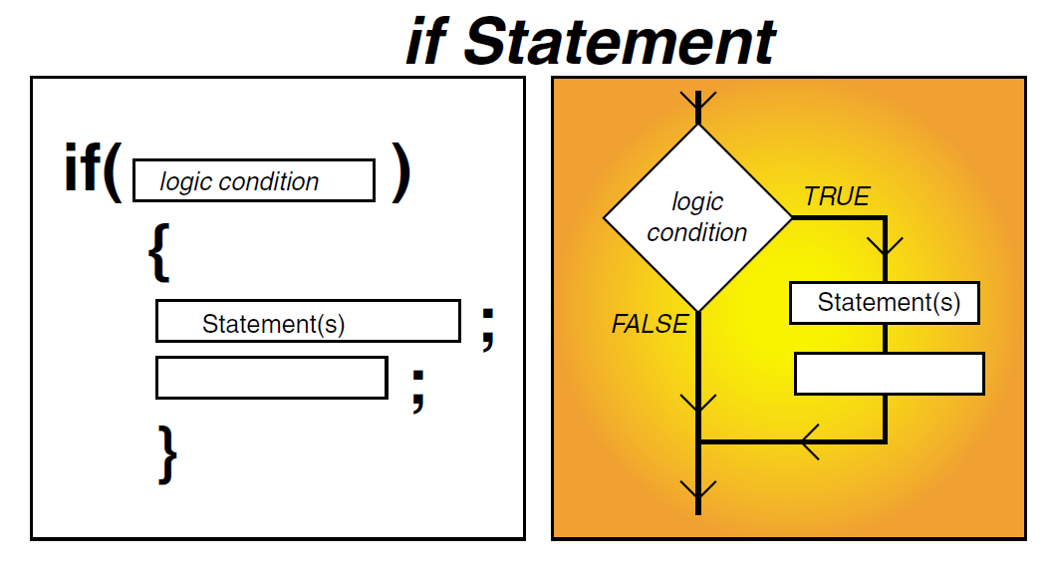

Slide 17
3.5 The if selection statement
Selection structure:
  Used to choose among alternative courses of action
  Pseudocode:
    If student’s grade is greater than or equal to 60
    Print “Passed”
If condition true
  Print statement executed and program goes on to next statement
  If false, print statement is ignored and the program goes onto the next statement
  Indenting makes programs easier to read
    C ignores whitespace characters

Slide 18

Fig. 3.2 | Flowcharting the single-selection if statement.

Slide 19
3.5 The if selection statement
Pseudocode translated to statement in C:
    if ( grade >= 60 )
    {
    printf( "Passed\n" );
    }
  C code corresponds closely to the pseudocode

Slide 20
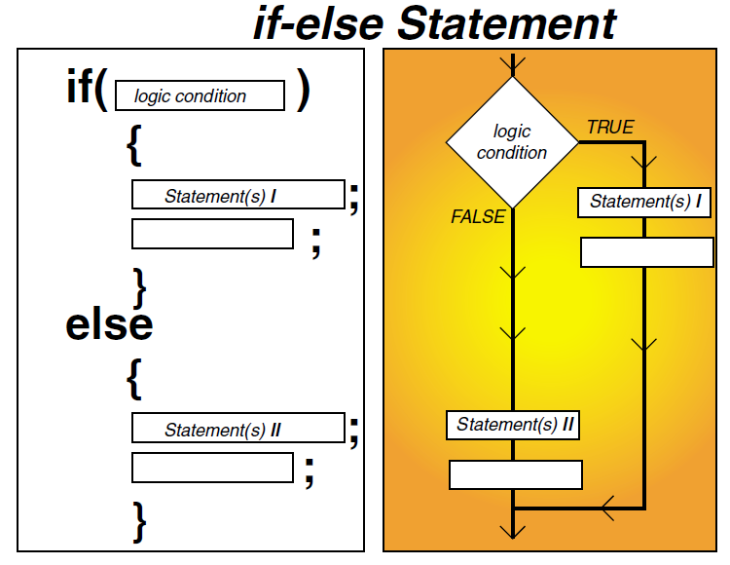

Slide 21
3.6 The if…else selection statement
if
  Only performs an action if the condition is true
if…else
  Specifies an action to be performed both when the condition is true and when it is false
Psuedocode:
    If student’s grade is greater than or equal to 60
    Print “Passed”
    else
    Print “Failed”
  Note spacing/indentation conventions

Slide 22
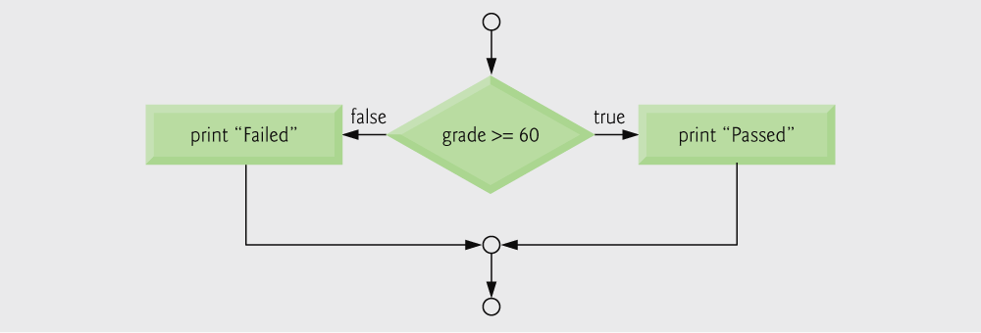
Fig. 3.3 | Flowcharting the double-selection if...else statement.

Slide 23
3.6 The if…else selection statement
C code:
    if ( grade >= 60 )
    {
    printf( "Passed\n");
    printf( "Your grade is %d \n", grade);
    }
    else
    {
    printf( "Failed\n");
    printf( "Your grade is %d \n", grade);
    }

Slide 24
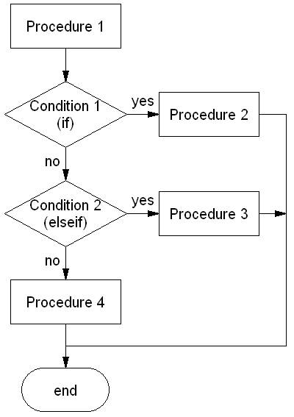
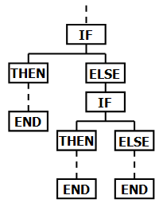
if - else if - else

Slide 25
if-else if-else
Psuedocode:
    If student’s grade is greater than 80
    Print “you got A” and Print grade
    else if student grade is between 60 and 80
    Print “passed with normal grade” and print grade
    else if student grade is between 50 and 60
    Print “passed marginally” and print grade
    else
    Print “failed” and print grade

Slide 26
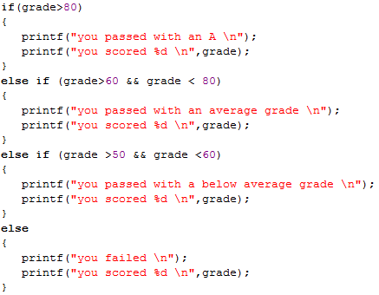
If - else if - else
C code for above;

Slide 27
Nested if
if blocks within if blocks
Psuedocode:
    If student’s grade is greater than 50
    Print “you got passed’’
    if students grade is greater than 80
    print “congratulations”
    else if student grade is between 50 and 60
    print “you passed averagely”
    else
    print “you failed”
    if student grade less than 30
    print “did you even read?”
    print grade

Slide 28
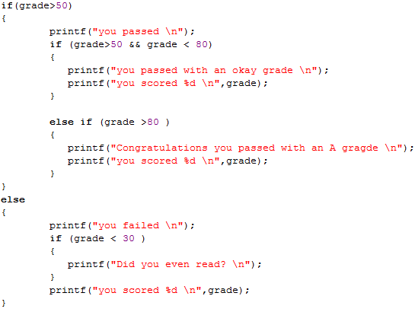
Nested if
Code for above example:

Slide 29
Ternary conditional operator (?:)
For simple one line selection statements
Takes three arguments (condition, value if true, value if false)
For first example we could have been written:
grade >= 60 ? printf( “Passed\n” ) : printf( “Failed\n” );

Slide 30
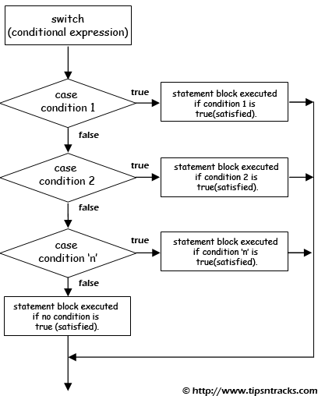
Switch

Slide 31
switch Multiple-Selection Statement
switch
  Useful when a variable or expression is tested for all the values it can assume and different actions are taken
Format
  Series of case labels and an optional default case
    switch ( value ){
      case '1':
        actions
      case '2':
        actions
      default:
        actions
      }
  break; exits from statement

Slide 32
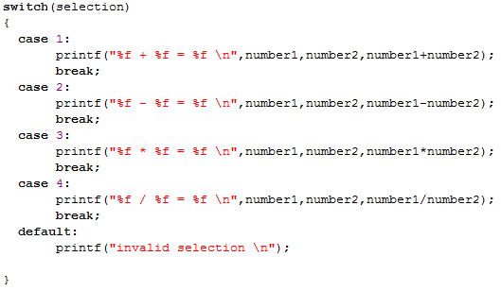
Switch example

